Slide 1
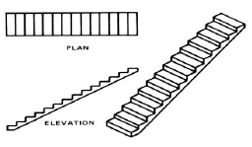
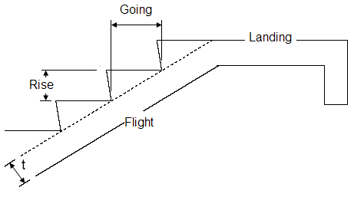
Stair Types
Straight stairs

Slide 2
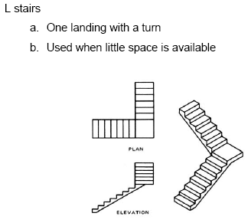

Slide 3
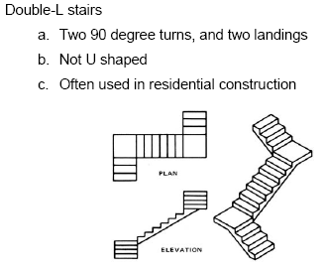

Slide 4
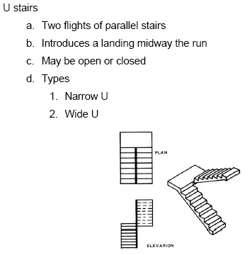

Slide 5
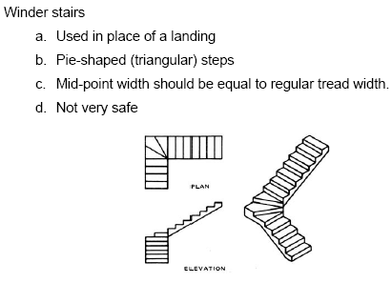

Slide 6
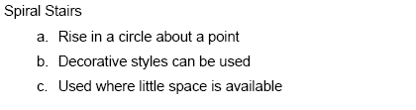
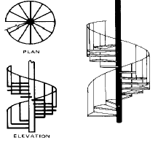

Slide 7
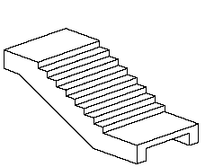
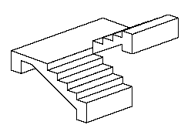
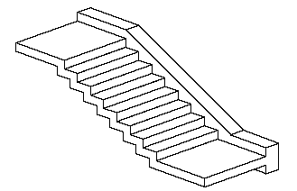
Stair Type based on the structural loading type
Simply supported stair
(transversely supported)
Longitudinally supported stair
Cantilever stair

Slide 8
Simply supported stair
Design a straight flight stair in a residential building supported on reinforced concrete wall 1.5 m )(center to center)
L.L = 3kN/m2
Covering Material = 0.5kN/m
The riser are 16cm and goings are 30 cm

Slide 9

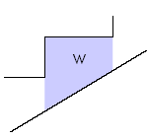
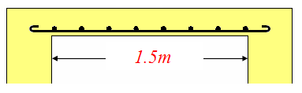
Loads and Analysis
D.L(O.W) =0.34*0.075*25 + 0.5*0.16*0.3*25=1.24 kN/m
D.L (covering material) = 0.5 kN/m
D.L (total) = 1.74 kN/m
L.L =3*(0.3) =0.9 kN/m
0.3
0.16
0.34

Slide 10
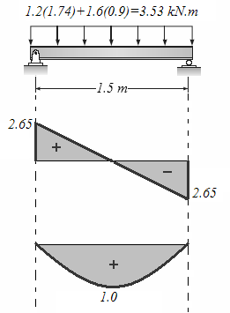

Slide 11
Design for moment
Design for shear

Slide 12
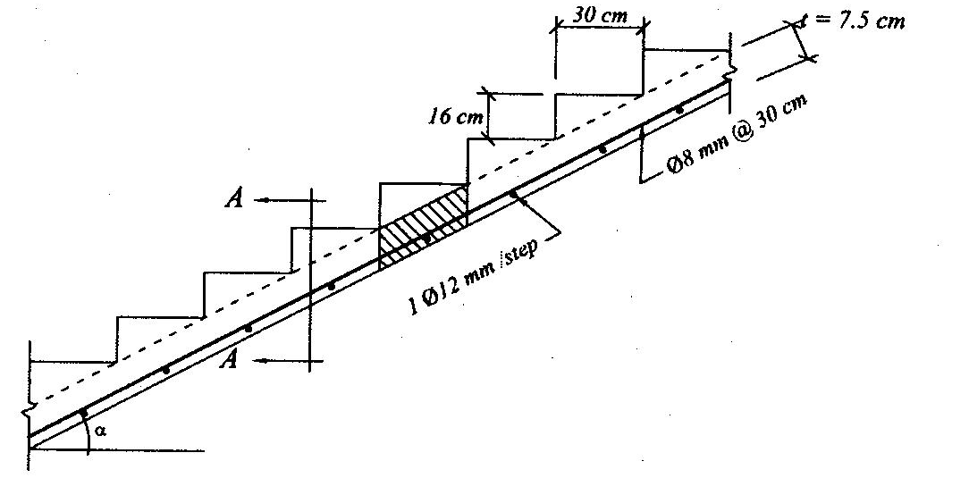
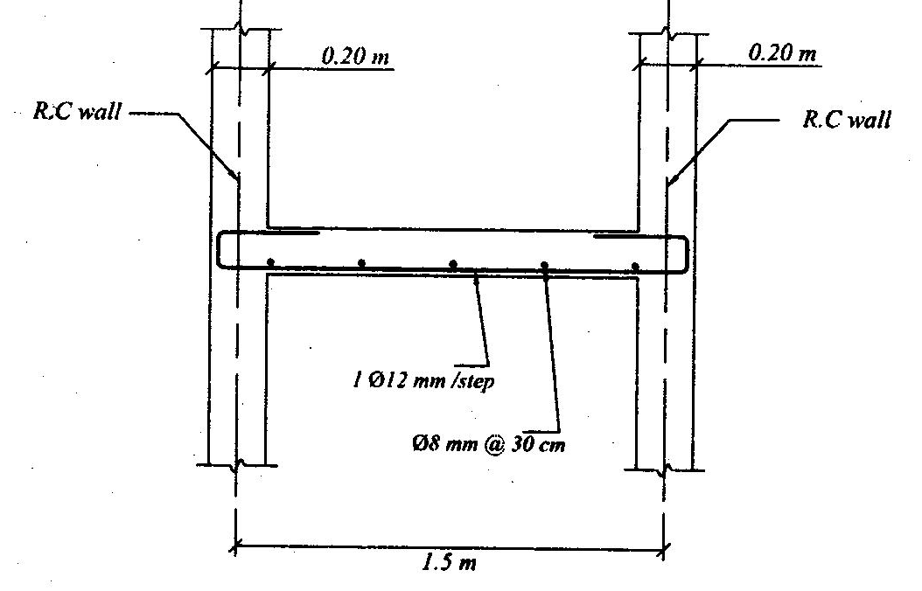

Slide 13
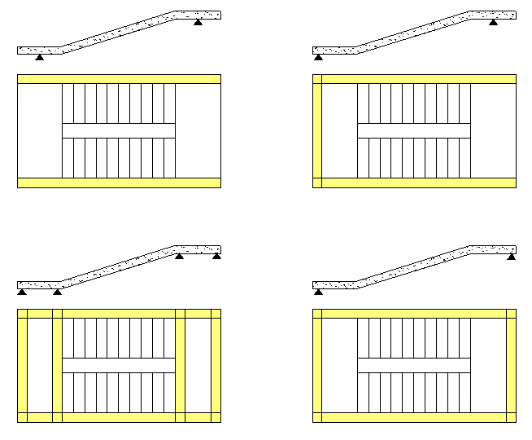
Longitudinal – Supported stairs

Slide 14
Longitudinal – Supported stairs (Example)
Design a U- stair in a residential building L.L = 3 kN/m2
Covering Material = 2 kN/m²
The riser are 16 cm and goings are 30 cm

Slide 15
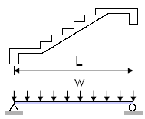
Loads and Analysis
D.L (slab) = 0.22*25 =5kN/m2
D.L (step) = 0.5*0.16*25=2 kN/m2
D.L (covering material) = 2 kN/m2
D.L (flight) = 9 kN/m2
D.L (landing) = 7 kN/m2
L.L =3 kN/m2
W_{u} (flight) = 1.2(9)+1.6(3)=15.6kN/m
W_{u} (landing) = 1.2(7)+1.6(3)=13.2kN/m

Slide 16

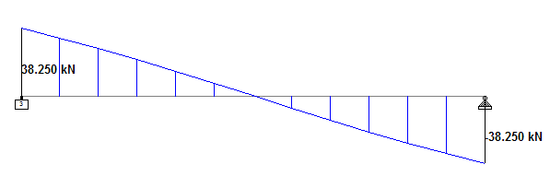
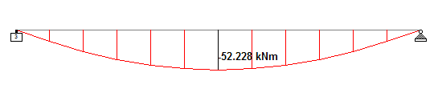

Slide 17
Design for moment
Design for shear

Slide 18
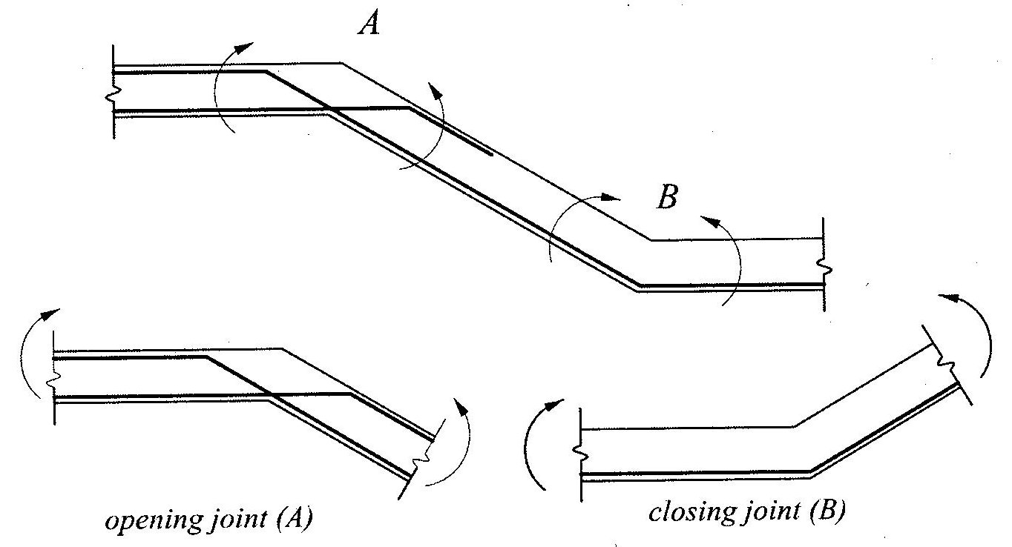
Reinforcement Notes

Slide 19
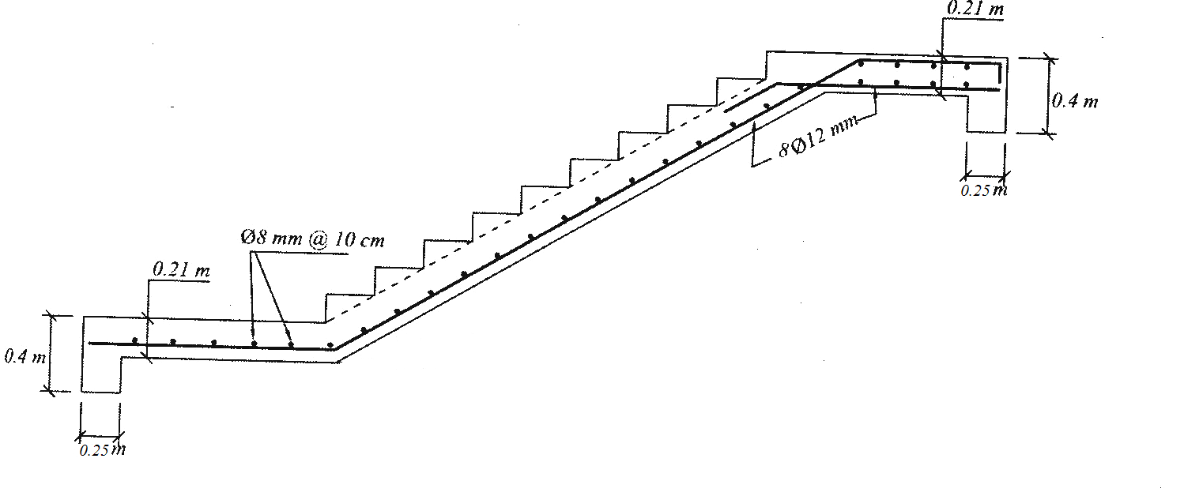

Slide 20
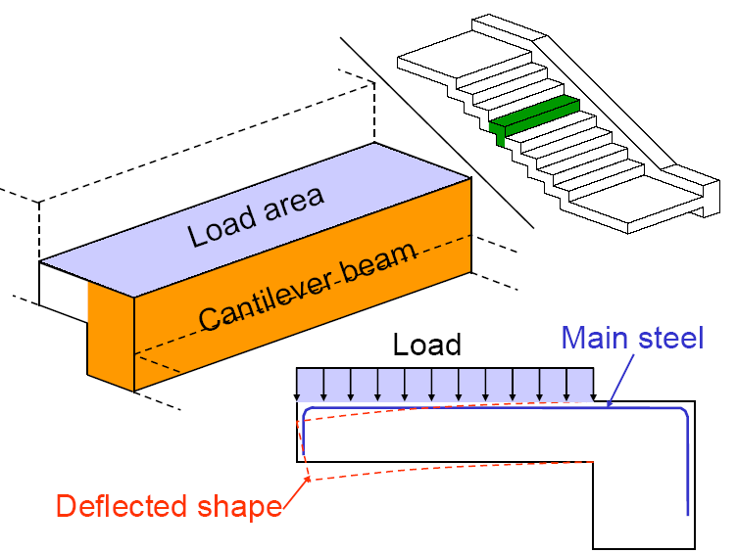
Cantilever Stair

Slide 21
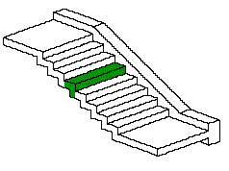
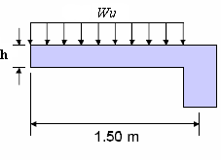
Cantilever stairs (Example)
Design a cantilever straight flight stair in a residential building
L.L = 3kN/m2
Covering Material = 0.5kN/m
The riser are 16cm and goings are 30 cm

Slide 22
D.L(O.W) =0.15*0.075*25 + 0.15*0.075*25=0.6 kN/m
D.L (covering material) = 0.5 kN/m
D.L (total) = 1.1 kN/m
L.L =3*(0.3) =0.9 kN/m
Wu = 1.2(1.1)+1.6(0.9) = 2.76 kN/m
Vu = 2.76(1.5) = 4.14 kN
Mu = W_{u}L²/2 = 3.1 kN.m
15
15
7.5

Slide 23
Design for moment
Design for shear

Slide 24
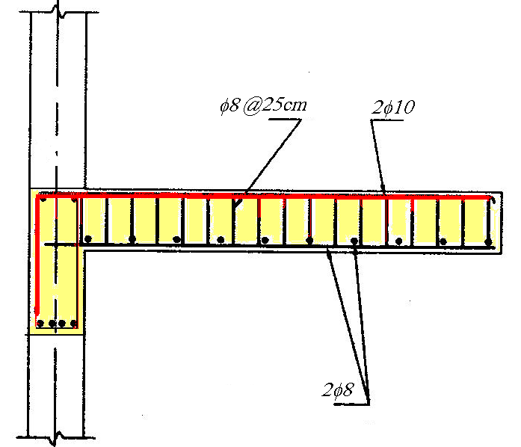

Slide 25

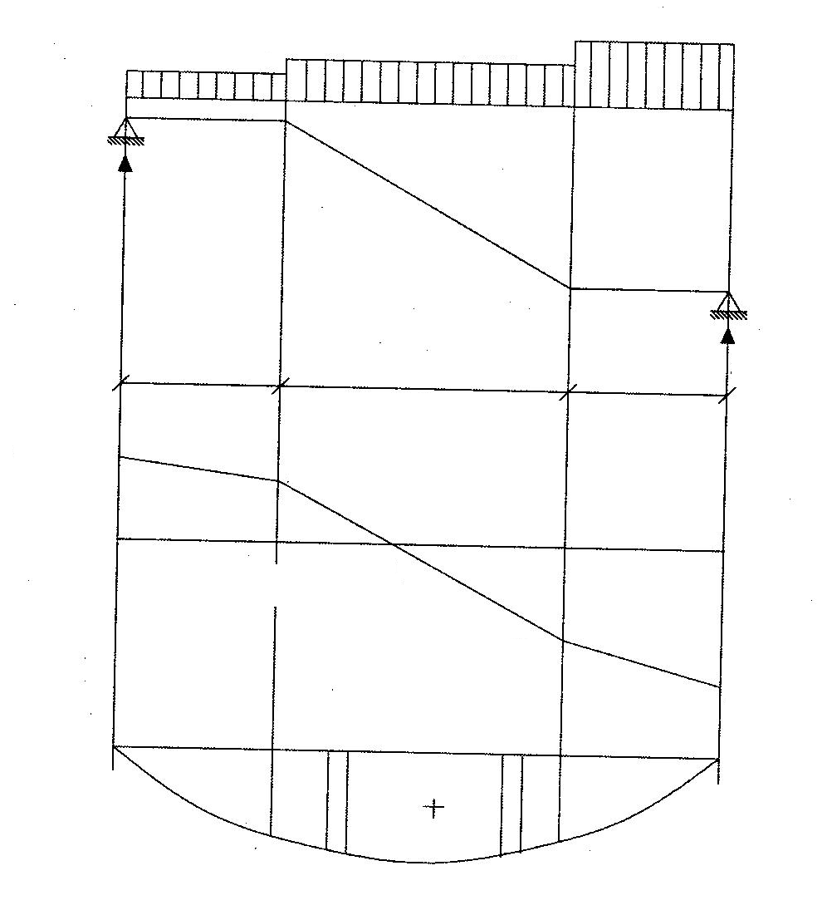
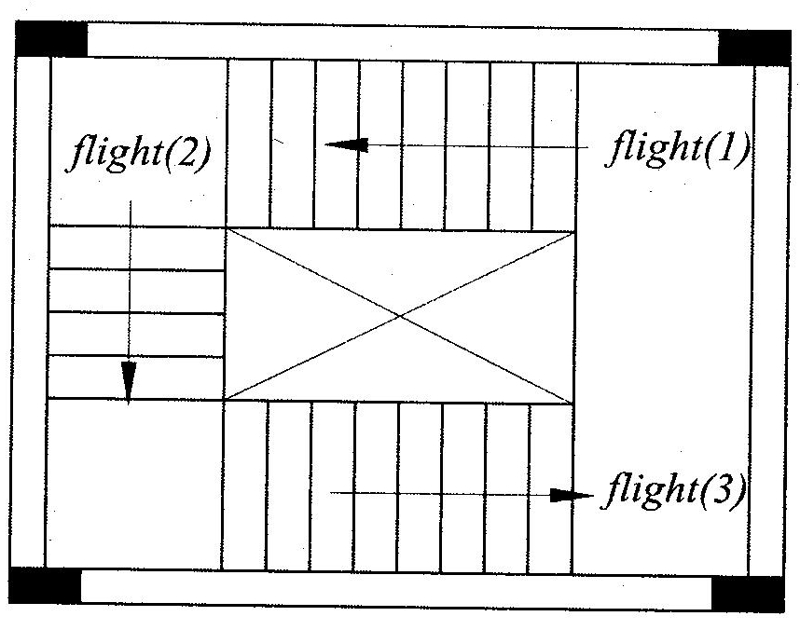
Longitudinal – Supported stairs
Open-well stairs

Slide 26
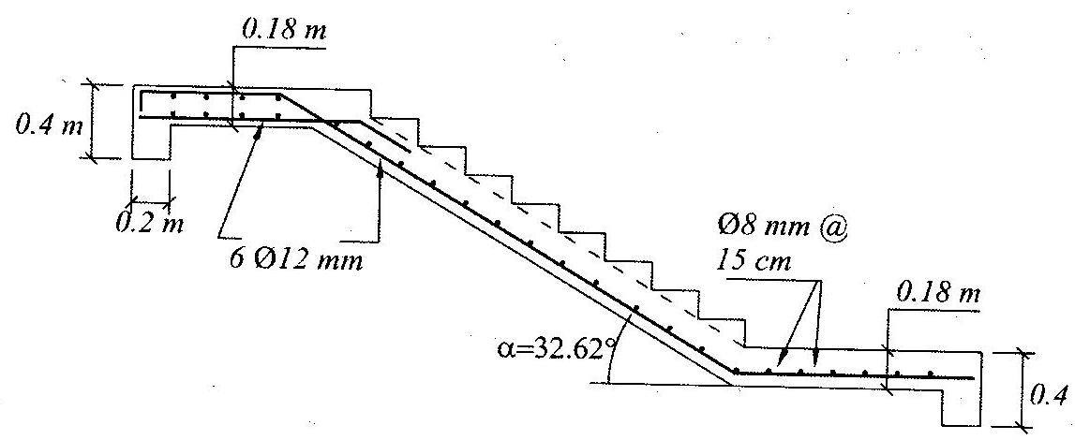

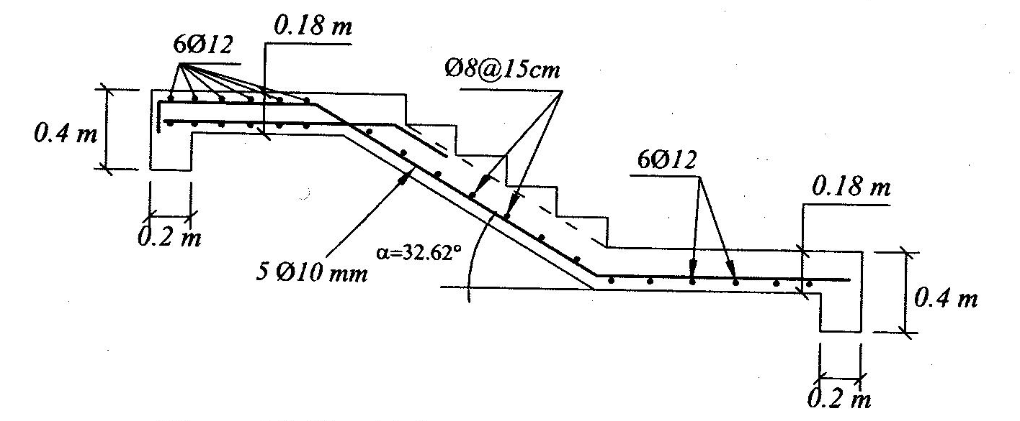

General Example

